Slide 1
IMAGE PROCESSING
By
Viral 3

Slide 2
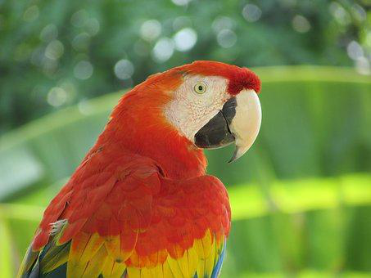
Reading, saving, and displaying an image using PIL:
The PIL function, open(), reads an aimage from disk in n Image object, as shown in the following code. The image is loaded as an object of the PIL.PngImagePlugin.PngImageFile class.
***Providing the correct path to the images on the disk***
how to use the PIL function, convert(), to convert ...
im_g = im.convert('L')

